Slide 1
Photo Album
by GVPCEW

Slide 2
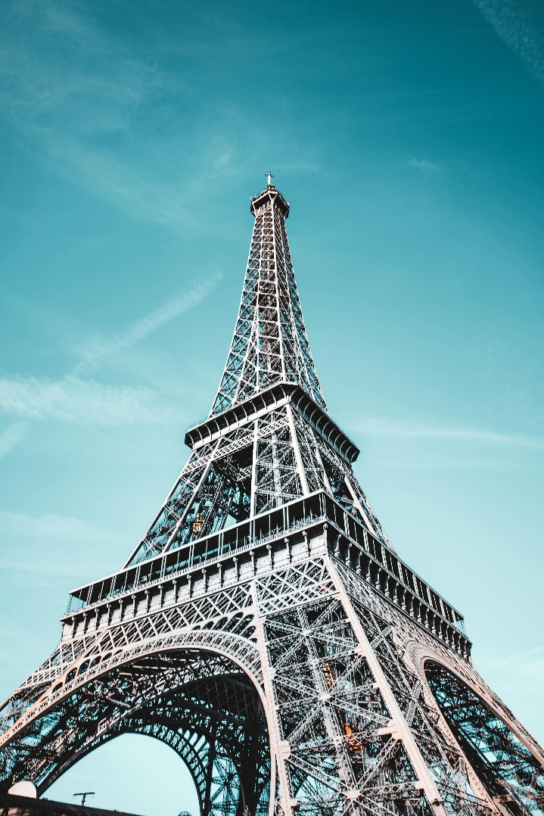
Eiffel tower, paris

Slide 3
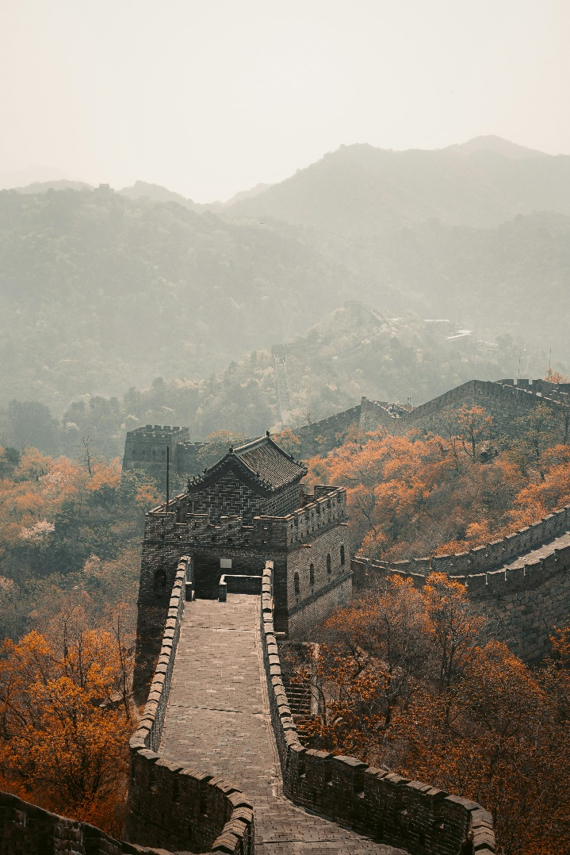
The great wall of china

Slide 4
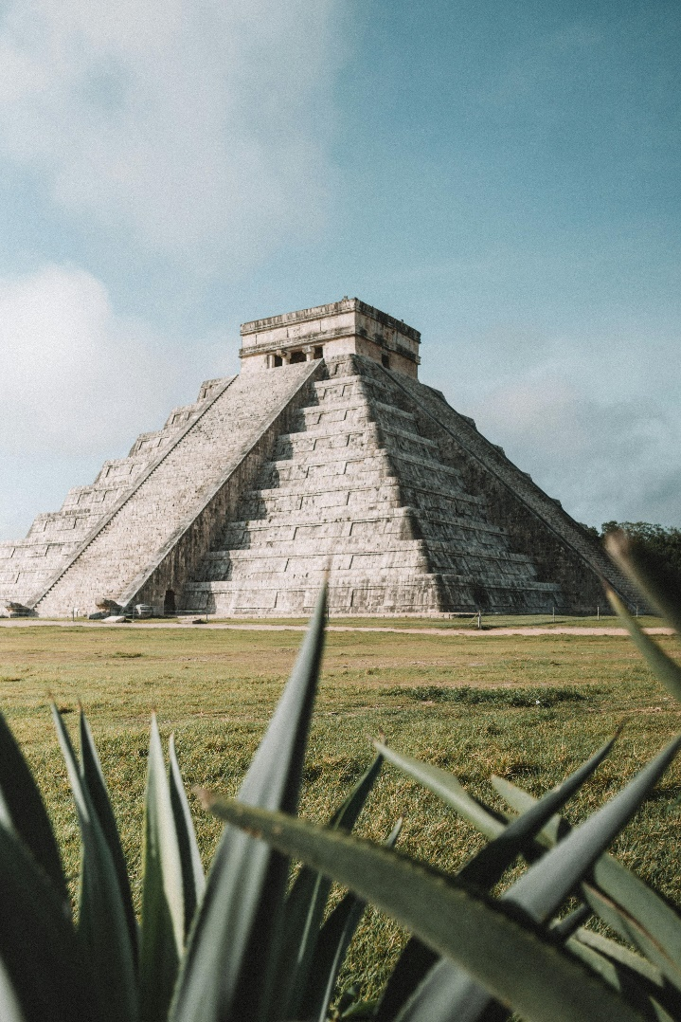
pyramid

Slide 5
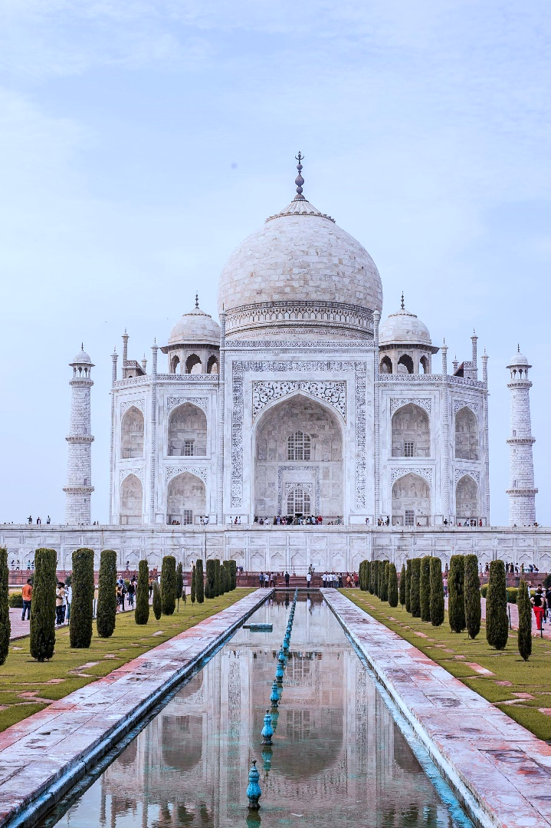
Taj mahal

Slide 6
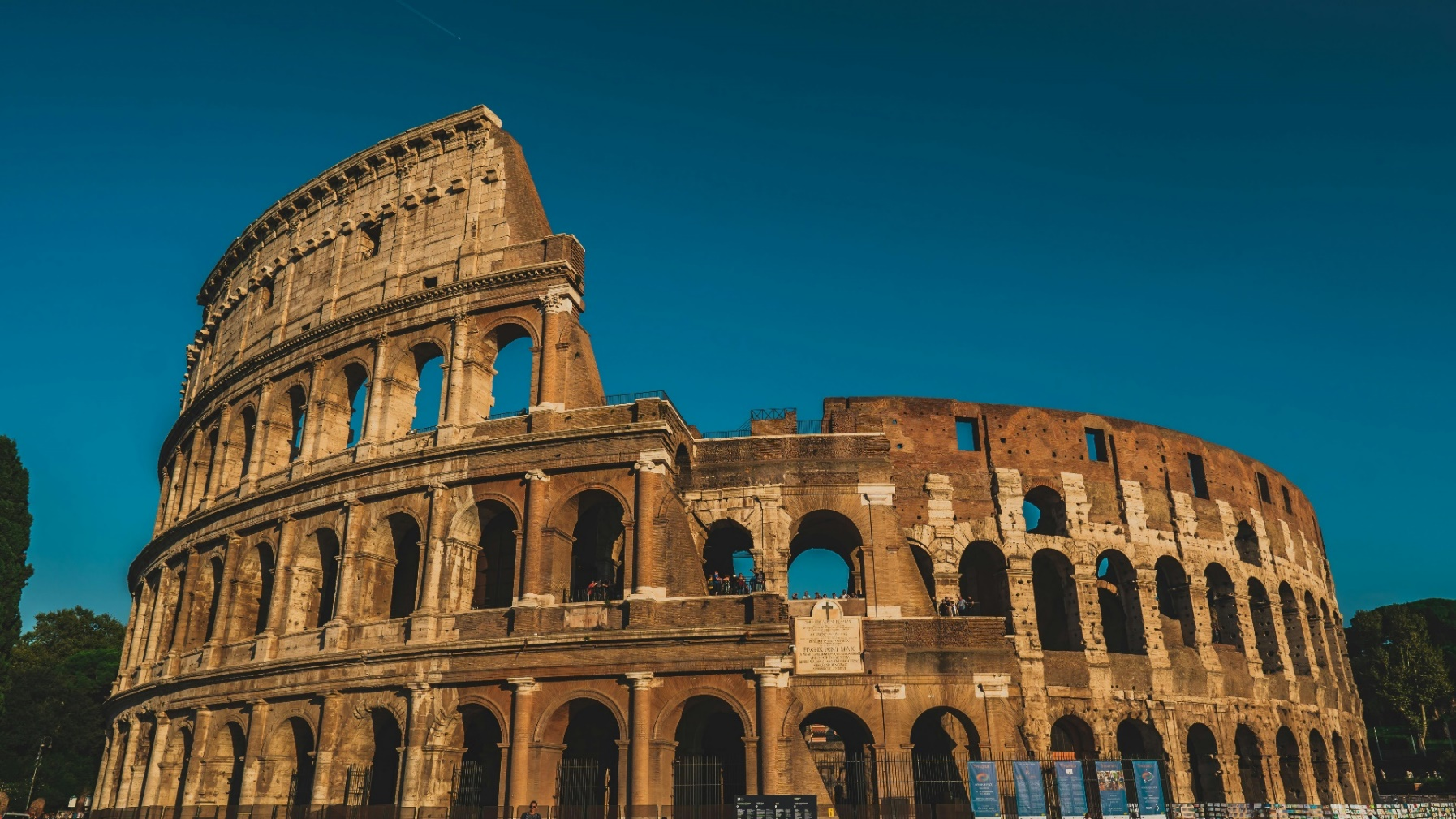
the colosseum

